Slide 1
Conceptual Partitioning:
An Efficient Method for Continuous Nearest Neighbour Monitoring by Kyriakos Mouratidis, Marios Hadjieleftheriou and Dimitris Papadias
June, 2005
presented by Meltem Yıldırım
Boğaziçi University, 2005

Slide 2
Agenda
Problem
Solution: Conceptual Partitioning Monitoring (CPM)
Extensions of the Solution
Performance Analysis
Conclusion

Slide 3
What is the Problem?
Problem:
continously monitoring the nearest neighbours of certain objects in a dynamic environment
Some Wireless Mobile Applications: Fleet management, location-based services
A set of moving objects
A central server that
  monitors their positions over time
  processes continuous queries from geographically distributed clients
  reports up-to-date results
Naive approach:
  the server constantly obtains the most recent position of all objects
  transmission of a large number of rapid data streams corresponding to location updates

Slide 4
Purpose (formal)
Spatial Data: data with position information (location, shape, size, relationships to other entities)
Spatial Query: querying objects based on their geometry
P = {p₁, p₂, …, p_{n}} → set of objects
q: a query point
k-NN query: k nearest neighbour query which retrieves the k objects in P that lie closest to q
The problem is well studied for static datasets but not for highly-dynamic environments with continuous multiple queries
p₁
p₆
2-NN
1-NN
p₂
q
3-NN
p₅
p₃
p₄

Slide 5
Related Work
Methods focusing on range query monitoring:
Q-index, MQM, Mobieyes, SINA
It is almost impossible to extend them to NN queries
Methods that explicitly target NN processing:
DISC, YPK-CNN, SEA-CNN

Slide 6
CPM – Conceptual Partitioning Monitoring
Symbol | Description
P | The set of moving objects
N | Number of objects in P
G | The grid that indexes P
δ | Cell side length
q | The query point
c_{q} | The cell containing q
n | The number of queries installed in the system
dist(p,q) | Euclidean distance from object p to query point q
best_NN | The best NN list of q
best_dist | The distance of the k^{th} NN from q
mindist(c, q) | Minimum distance between cell c and q
2D data objects and queries that change their location frequently and in an unpredictable manner
An update from object p is a tuple
<p.id, x_{old}, y_{old}, x_{new}, y_{new}>
A central server receives the update stream and continuosly monitors the k NNs of each query q
Grid index
Each cell is δxδ

Slide 7
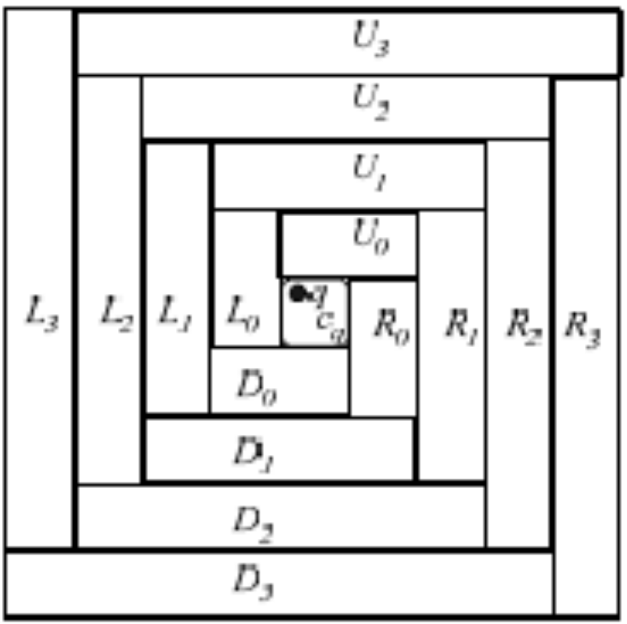
CPM – Conceptual Space Partitioning
Each rectangle has
  direction
  level number
For rectangles DIR_{j} and DIR_{j+1},
mindist(DIR_{j+1},q) = mindist(DIR_{j}, q) + δ
CPM visits cells in ascending mindist(c, q) order

Slide 8
CPM – Data Structures
<q_{x}, q_{y}>
.
.
.
q
.
.
.
Object list
best_NN set
... p ...
Grid
best_dist
c
Influence list
search_heap
... q ...
visit_list
Query Table Structure
Object Grid Structure

Slide 9
CPM – NN Computation Module
initialize an empty heap , best_dist = ∞
and best_NN = Ø, visit_list = Ø
insert the following into H
  <c_{q}, 0>
  <DIR₀, mindist(DIR₀, q)>
repeat:
  Get the next entry of H
  If it is a cell,
    For each pЄc, update best_NN and best_dist if necessary
    insert an entry for q into the influence list of c
    insert <c, mindist(c, q)> at the end of the visit_list
  Else
    For each cell c in DIR, insert <c, mindist(c, q)> into H
    Insert the next-level rectangles into H
until H is empty or the next entry in H has
mindist ≥ best_dist

Slide 10
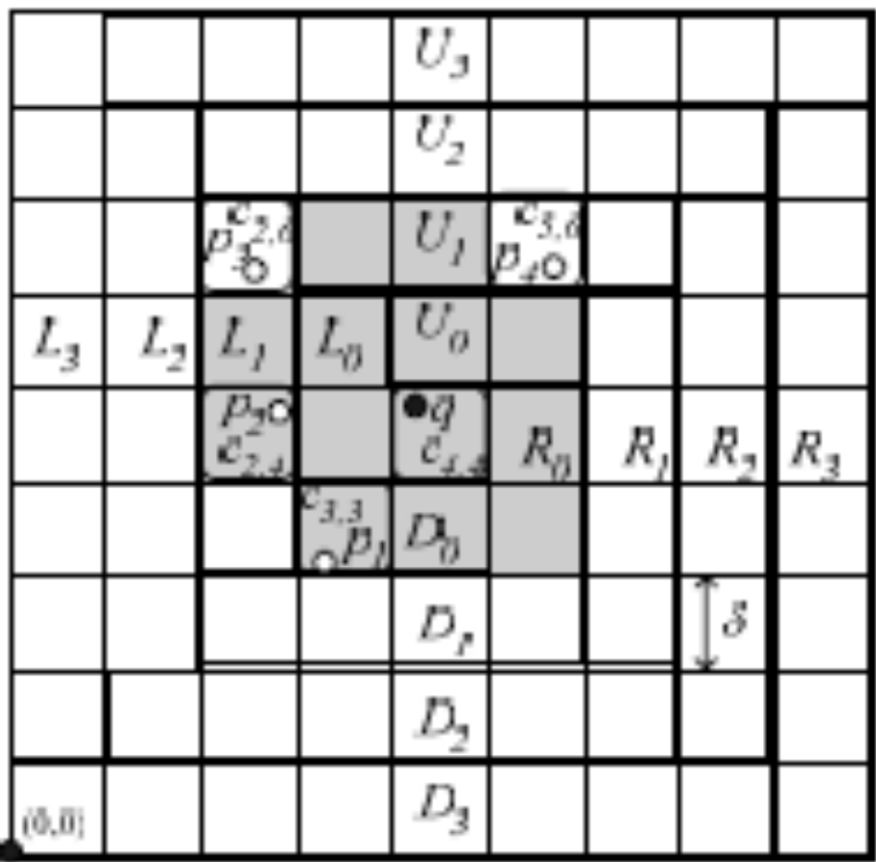
CPM - Example
Heap
<c_{4,4}, 0>
<U₀, 0.1>
<L₀, 0.2>
<R₀, 0.8>
<D₀, 0.9>
empty and ignored
enheap the cells of U₀
and the rectangle U₁
enheap the cells of L₀
and the rectangle L₁
…we come across p₁ Є c_{3,3}
best_dist = dist(p₁, q) = 1.7
<c_{4,5}, 0.1>
<c_{5,5}, 0.81>
<U₁, 1.1>
…we come across p₂ Є c_{2,4}
best_dist= dist(p₂, q) = 1.3
<c_{3,4}, 0.2>
<c_{3,5}, 0.22>
<L₁, 1.2>
…we come across c_{5,6} since
mindist(c_{5,6}, q) ≥ best_dist
δ = 1, q = 1-NN

Slide 11
CPM – Handling a Single Object Update
When p moves from c_{old} to c_{new}
  Delete p from c_{old} and scan the influence_list of c_{old}
    if p Є q.best_NN and dist(p, q) ≤ best_dist → reorder best_NN
    if p Є q.best_NN and dist(p, q) > best_dist → mark q as affected
  Add p into c_{new} and scan the influence_list of c_{new}
    if dist(p, q) < q.best_dist
      remove the current k^{th} NN from q.best_NN
      insert p into q.best_NN
      update q.best_dist
  Re-compute the best_NN of every affected query (sequential processing of visit_list and H)

Slide 12
CPM – Handling Multiple Object Updates
O: set of outgoing objects
I: set of incoming objects
I U best_NN – O
If |I| ≥ |O|
  influence region of q includes at least k objects
  new best_NN can be formed easily without invoking recomputation
  Scan visit_list and look for where
  best_dist_{new} < mindist(c, q) < best_dist_{old}

Slide 13
CPM – Handling Query Updates
When a query is terminated
  Delete its entry from QT
  Remove it from the influence lists of the cells in its influence region
When a new query is inserted
  NN Computation Algorithm
When a query moves
  Termination + Insertion

Slide 14
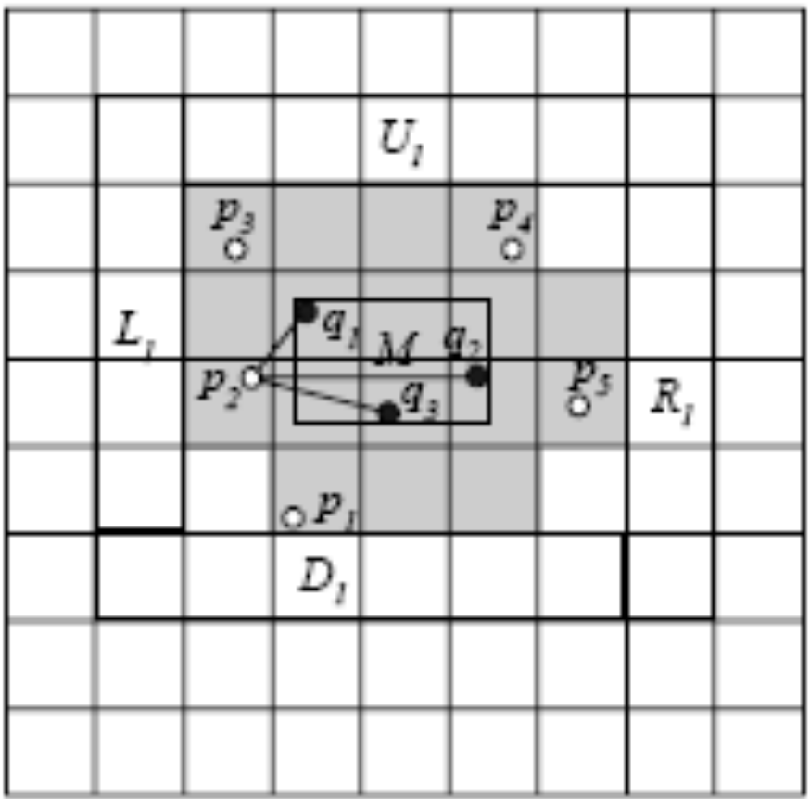
Aggregate NN Queries - SUM
Q = {q₁, q₂, …, q_{m}}
Find p minimizing ∑_{qiЄQ} dist(p,q)
Difference:
  rectangle M containing all q_{i} Є Q
  enheap all the cells intersecting M

Slide 15
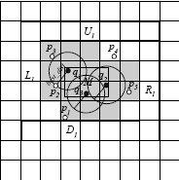
Aggregate NN Queries – MIN
Q = {q₁, q₂, …, q_{m}}
Find objects with the smallest distance(s) from any query in Q

Slide 16
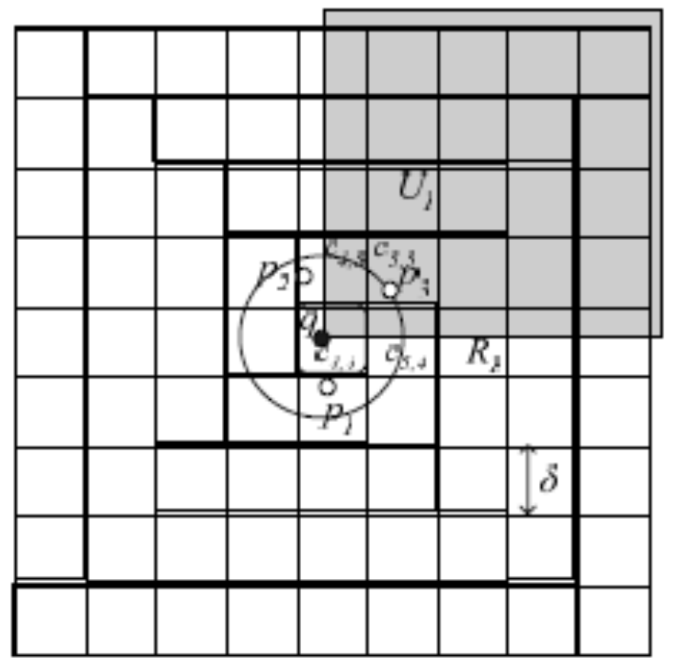
Constrained NN Queries
Only cells or rectangles intersecting the constraint region are added to the heap

Slide 17
Performance Analysis
Cell size:
  δ↑
    Cells consume more space, object_list↑, influence_list↑
    higher number of processed objects
  δ↓
    High overhead due to heap operations

Slide 18
Evaluation by Simulation
System Parameters
Roadmap of Oldenburg
Set of temporary objects (cars, pedestrians, etc.) and persistent NN queries
Default velocity values: slow, medium, fast
Comparison by YPK-CNN and SEA-CNN
Parameter | Default | Range
N: object population | 100K | 10, 50, 100, 150, 200 (K)
n: number of queries | 5K | 1, 2, 5, 7, 10 (K)
k: number of NNs | 16 | 1, 4, 16, 64, 256
Object / Query Speed | Medium | slow, medium, fast
Object agility | 50% | 10, 20, 30, 40, 50 (%)
Query agility | 30% | 10, 20, 30, 40, 50 (%)

Slide 19
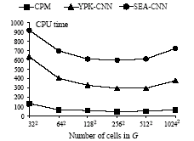
CPU time v.s. Grid Granularity
CPM
YPK-CNN
SEA-CNN
1000
900
800
700
600
500
400
300
200
100
0
CPU time
32² 64² 128² 256² 512² 1024²
Number of Cells in G

Slide 20
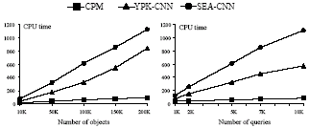
CPU time v.s. N and n
CPM
YPK-CNN
SEA-CNN
1200
1000
800
600
400
200
0
CPU time
1200
1000
800
600
400
200
0
CPU time
10K 50K 100K 150K 200K
1K 2K 5K 7K 10K
Number of Objects
Number of Queries
Effect of N
Effect of n

Slide 21
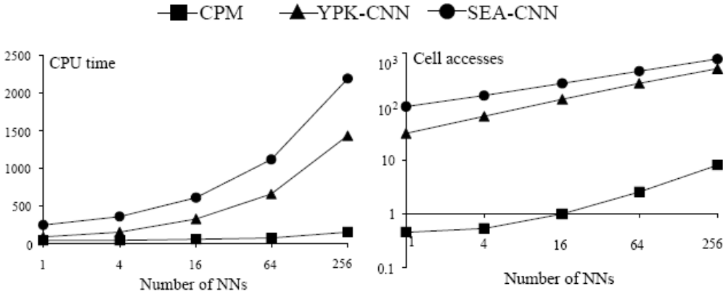
Performance v.s. k
CPM
YPK-CNN
SEA-CNN
2500
2000
1500
1000
500
0
CPU time
10³
10²
10
1
0.1
Cell accesses
1 4 16 64 256
1 4 16 64 256
Number of NNs
Number of NNs
CPU Time
Cell accesses

Slide 22
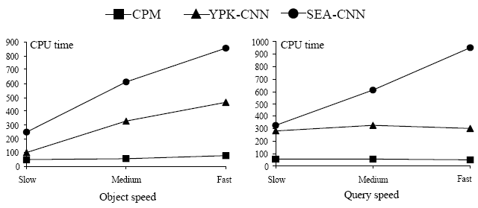
CPU time v.s. Object and Query Speed
CPM
YPK-CNN
SEA-CNN
900
800
700
600
500
400
300
200
100
0
CPU time
1000
900
800
700
600
500
400
300
200
100
0
CPU time
Slow Medium Fast
Slow Medium Fast
Object Speed
Query Speed
Effect of Object Speed
Effect of Query Speed

Slide 23
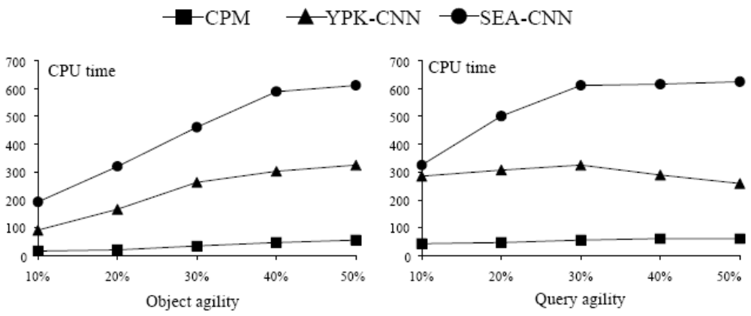
CPU time v.s. Object and Query Agility
CPM
YPK-CNN
SEA-CNN
700
600
500
400
300
200
100
0
CPU time
700
600
500
400
300
200
100
0
CPU time
10% 20% 30% 40% 50%
10% 20% 30% 40% 50%
Object Agility
Query Agility
Effect of Object Agility
Effect of Query Agility

Slide 24
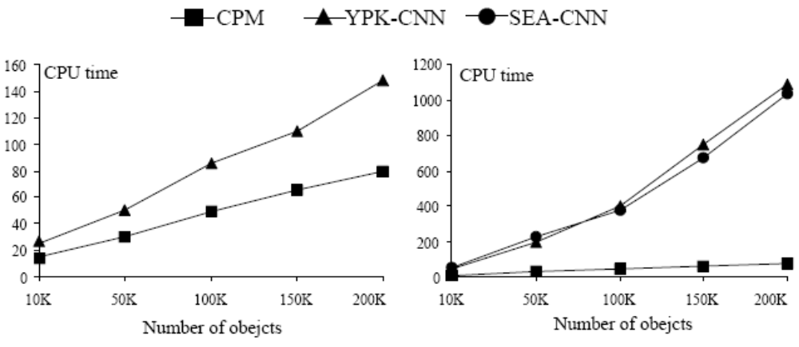
CPU time for Constantly Moving and Static Queries
CPM
YPK-CNN
SEA-CNN
160
140
120
100
80
60
40
20
0
CPU time
1200
1000
800
600
400
200
0
CPU time
10K 50K 100K 150K 200K
10K 50K 100K 150K 200K
Number of Objects
Number of Objects
Constantly Moving Queries
Static Queries

Slide 25
Conclusion
investigating the problem of monitoring continuous NN queries over moving objects
CPM:
  Low running time due to the elimination of unnecessary computations
  Makes use of visit_list and heap for recomputations
  Extending framework (aggregate, constrained NN queries)
  Performance evaluation

Slide 26
Questions?

Slide 27
Q-index
Assumes static range queries over moving objects
Queries are indexed by an R-tree
R-tree: splits space with hierarchically nested, and possibly overlapping, boxes
Each object p is assigned a region such that p needs to issue an update only if it exits this area
Moving objects probe the index to find the queries that they influence

Slide 28
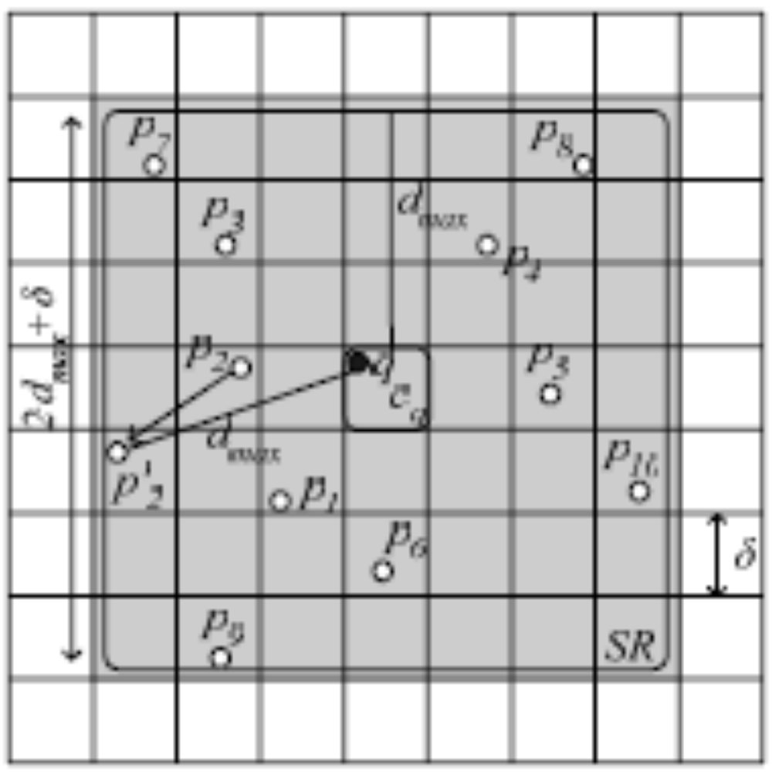
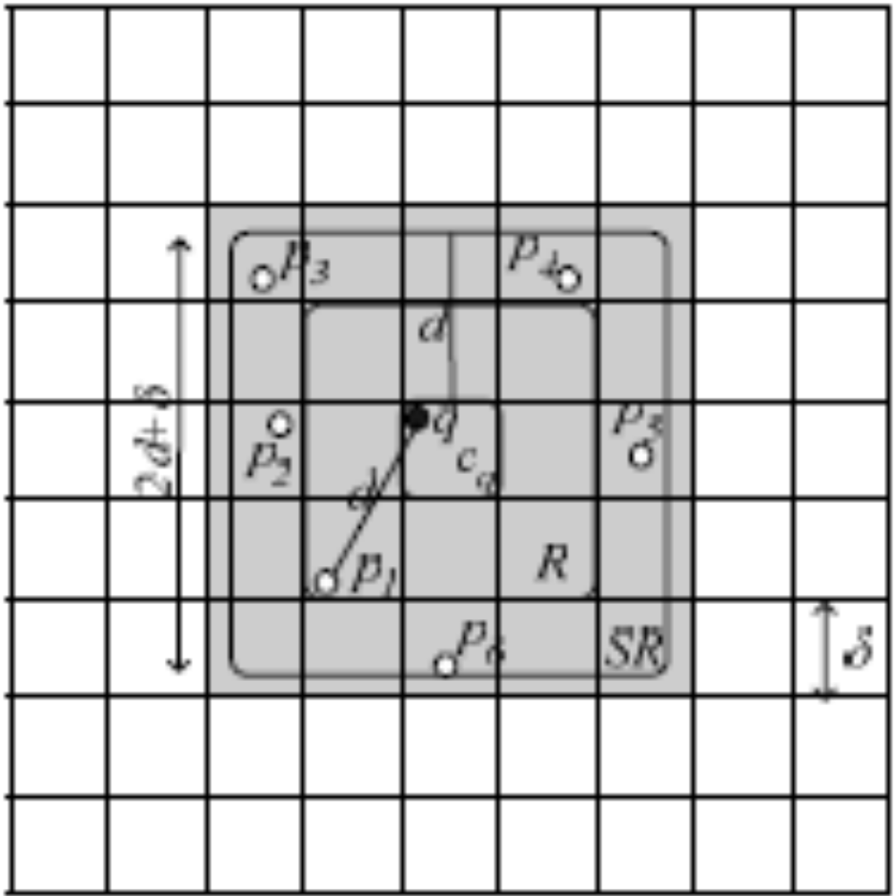
YPK-CNN
First evaluation of q (1-NN)
Update Handling (q = 1-NN)
Objects are indexed with a regular grid of cells where each cell is δxδ
Updates are not processed as they arrive, each query is re-evaluated every T time units
The first evaluation of a query q:
  visit the cells in a square R around the cell c_{q} covering q until k objects are found
  d = distance(q, k^{th} NN object)
  Search cells intersecting with square SR centered at c_{q} with side length 2d + δ
Re-evaluation of a query q:
d_{max}: distance of the previous neighbour that moved furthest
new SR: square centered at c_{q} with side length 2·d_{max}+ δ
When q changes location, it is handled as a new one
2d_{max} + δ
2d + δ
d_{max}
d
R
SR
SR

Slide 29
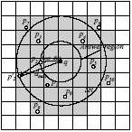
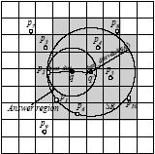
SEA-CNN
q moves to q'
p₂ issues an update (q = 1-NN)
No module for the first evaluation of a query q
best_dist: distance between q and the k^{th} NN
answer region of a query q: circle with center q and radius best_dist
The cells intersecting the answer region of q hold book-keeping information to indicate this fact
Determines a circular region SR around q and computes the new k NN set of q

Slide 30
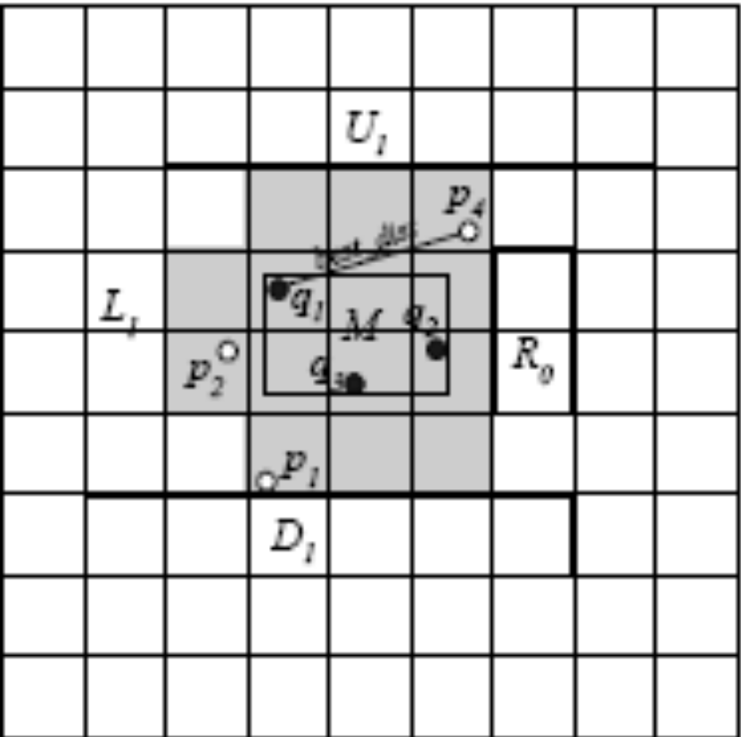
Aggregate NN Queries - MAX
Q = {q₁, q₂, …, q_{m}}
Find objects with the lowest maximum distance(s) from any query in Q

